Slide 1
autostitching
Fabian Tan Hann Shen
20185112
DongSeo University

Slide 2
Table of Content
Self introduction
Introduction to Autostitching
Application
Experiment
Result

Slide 3
Self Introduction
Name : Fabian Tan Hann Shen
Country : Malaysia
Education Background :
Faculty of Electronics Engineering - Multimedia University, Malaysia
Department of Computer Engineering – Dongseo University, South Korea.
Research Interest : Machine Learning/Deep Learning ( Few-shot learning)
Supervisor : Prof. Dae-Ki Kang

Slide 4
autostitch
What is image stitching?
Combine two or more photographic images to generate panorama or high resolution image.
What is autostitch?
AutoStitch takes a step forward in panoramic image stitching by automatically recognizing matching images.
In order to compose a panoramic images, it is fed with two or more images from a camera and stitch them together.
How does it work?
It works on unordered collections of images, and find the matching features between the images using SIFT algorithms.
Robustly align all images and uses advanced blending algorithms to form panorama
Notes:
What is image stitching?
Image stitching is the process whereby combines multiple photographic images with overlapping fields of views to producea panorama or high resolution image. There are a few considerations to take in, one lens distortion and detectable features.

Slide 5
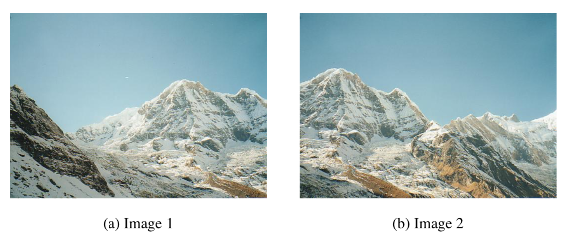
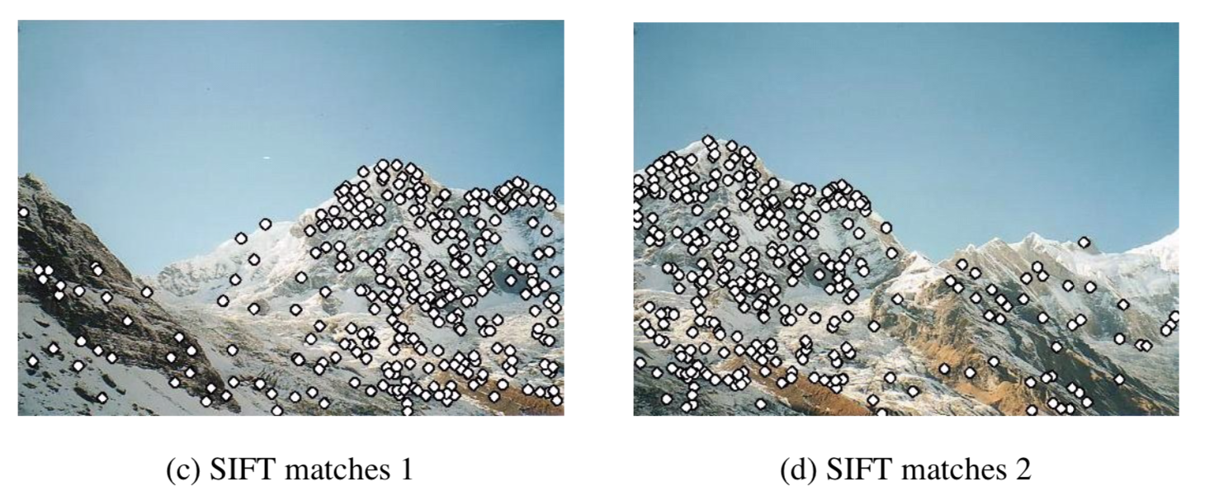
How does it work? feature matching
Feature matching
extract and match SIFT features between the images. SIFT features are located at scale-space max/min of a difference of Gaussian function.
The invariant descriptor is computed by accumulating local gradient in orientation histogram
SIFT features are invariant under rotation and scale changes, so it can handle images with varying orientation and zoom, unlike Harris corner.
Notes:
Sift features are extracted from all of images. After matching all of the features, the m images with the greatest number of feature matches to a given image are checked for image match
-
The first step of the panoramic recognition algorithm is to extract and match SIFT features between all of the images. At each feature location, a characteristic scale and orientation is established.
This gives a similarity invariant frame in which to make measurement. Since SIFT feature are invariant under rotation and scale changes, it can handle the images with varying orientation and zoom. Once features have been extracted from all images, they must be matched.
.

Slide 6
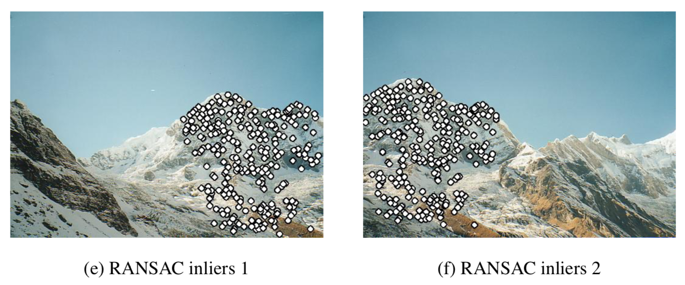
Ransac
Once all the image matches are extracted, have to identify images that have large number of matches between them.
RANSAC is a robust estimation procedure that uses minimal set of randomly sampled correspondences to estimate image transformation, and find a solution that has the best consensus with the data.
Then, perform RANSAC to select a set of inliers that are compatible with a homography between the images
Verify the image matching using probabilistic model.
Notes:
<First, RANSAC is performed to compute the homography and then a probabilistic model is invoked to verify the image match based on the number of inliers.
Use of invariant local features and probabilistic model to verify image matches allow us recognize multiple panoramas in unordered image sets, and stitch them fully automatically without user input. >
Then, at this stage – the objective is to find all matching feature.
Connected sets of images matches will become panoramas. Hence here the m images with the large number of matches of the feature will be identified to form panorama.
For each image – select m candidate matching images that have the most feature matches to this image. And find geometrically consistent feature matches using RANSAC to solve for the homography between pairs of image. verify the image matches using probabilistic model.
And we apply probability model to verify the match.

Slide 7
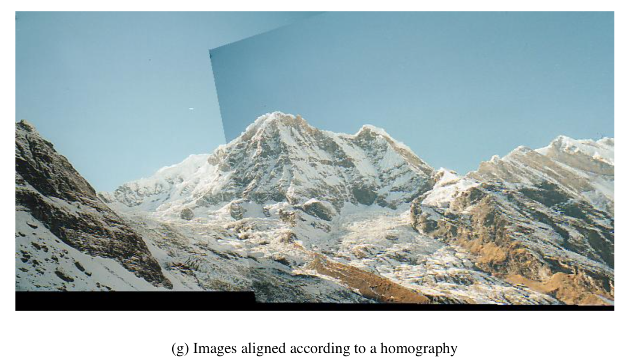
Bundle adjustment
Concatenate pairwise homographies.
Images are added to the bundle adjuster one by one, with the best matching image at each step.
Notes:
For each connected component, we perform bundle adjustment.
Given a set of geometrically consistent matches between images, we use bundle adjustment to solve for all of the camera parameters. It is essential because the concatenation of pairwise homographies would cause accumulated errors and disregard multiple constraints between images. Images are added to the bundle adjuster one by one, with the best matching image at each step.

Slide 8
Multiband blending
Render the panorama using multiband blending, as there will be some image edges are still visible
The idea of multiband blending
Blend low frequencies over a large spatial range, and high frequencies over a short range.
Smooth out the edges.
For each band, overlapping images are linearly combined using corresponding blend weight.
Notes:
The role of blending is to define how pixels of each image will be merged.
And then, we render the panorama using multi-band blending. Multibanding - There are some image edges are still visible due to a number of unmodelled effects, such as parallax effects due to unwanted motion of the optical center, misregistration errors due to mismodelling of the camera, radial distortion.
The idea behind multiband blending is to blend low frequencies over a large spatial range, and high frequencies over a short range. All these edges can be smoothed out using multiband blending.
For each band, overlapping images are linearly combined using the corresponding blend weights. This causes high frequency band to be blended over short ranges and low frequency bands are blended over larger range.
Multiband blending scheme ensure smooth transition between images despite illumination differences.

Slide 9
features
Takes various format of the images, that is BMP, PNG, JPEG
Produce panoramic images from a set of images
Blending options :
None
Linear
Multiband
Select the output size – height/weight/scale
Notes:
Multiband blending allows blending the overall colors and mitigate the differences in the scale or the exposure between the images to remove the sharp differences in the exposure.
Image blending involves executing the adjustments figured out in the calibration stage – combined with remapping of the images to an output projection.
Like color adjustment – to compensate for the exposure differences. Images are blended and seam line adjustment is done to minimize the visiblity of the seams between images.
What is gain compensation – to minimize the intensity of overlapping pixels.

Slide 10
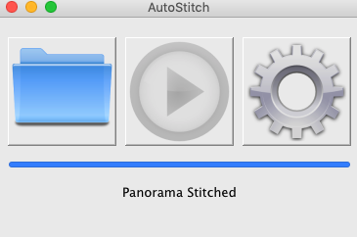
Experiment

Slide 11
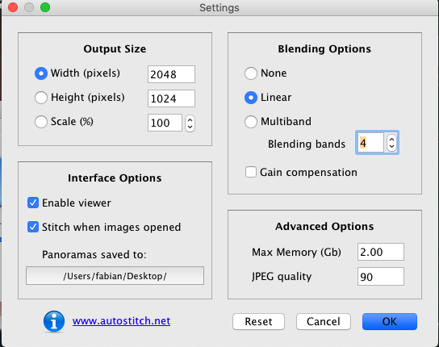
experiment

Slide 12
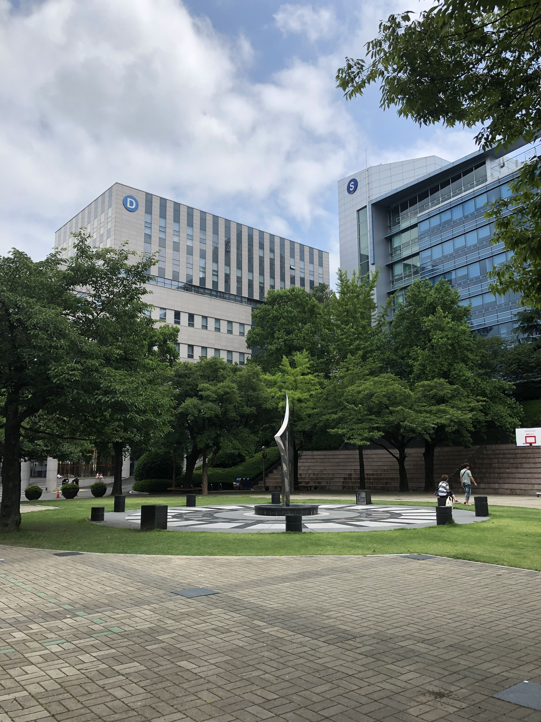
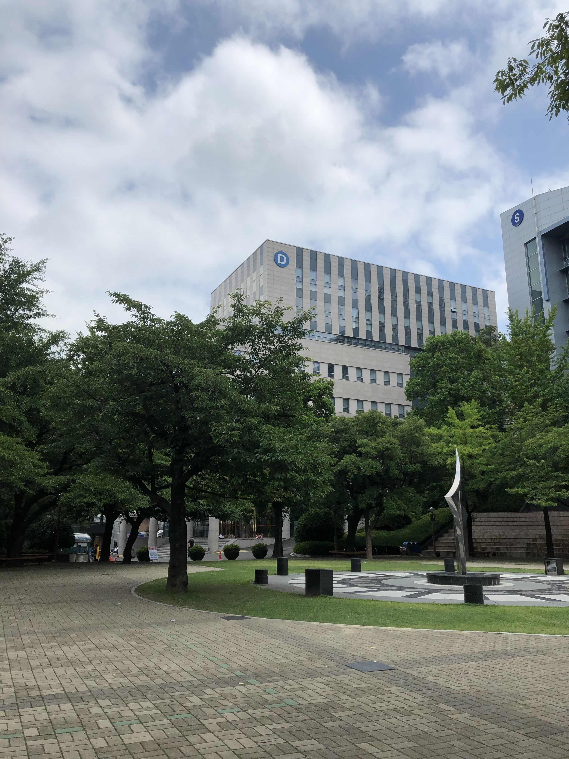
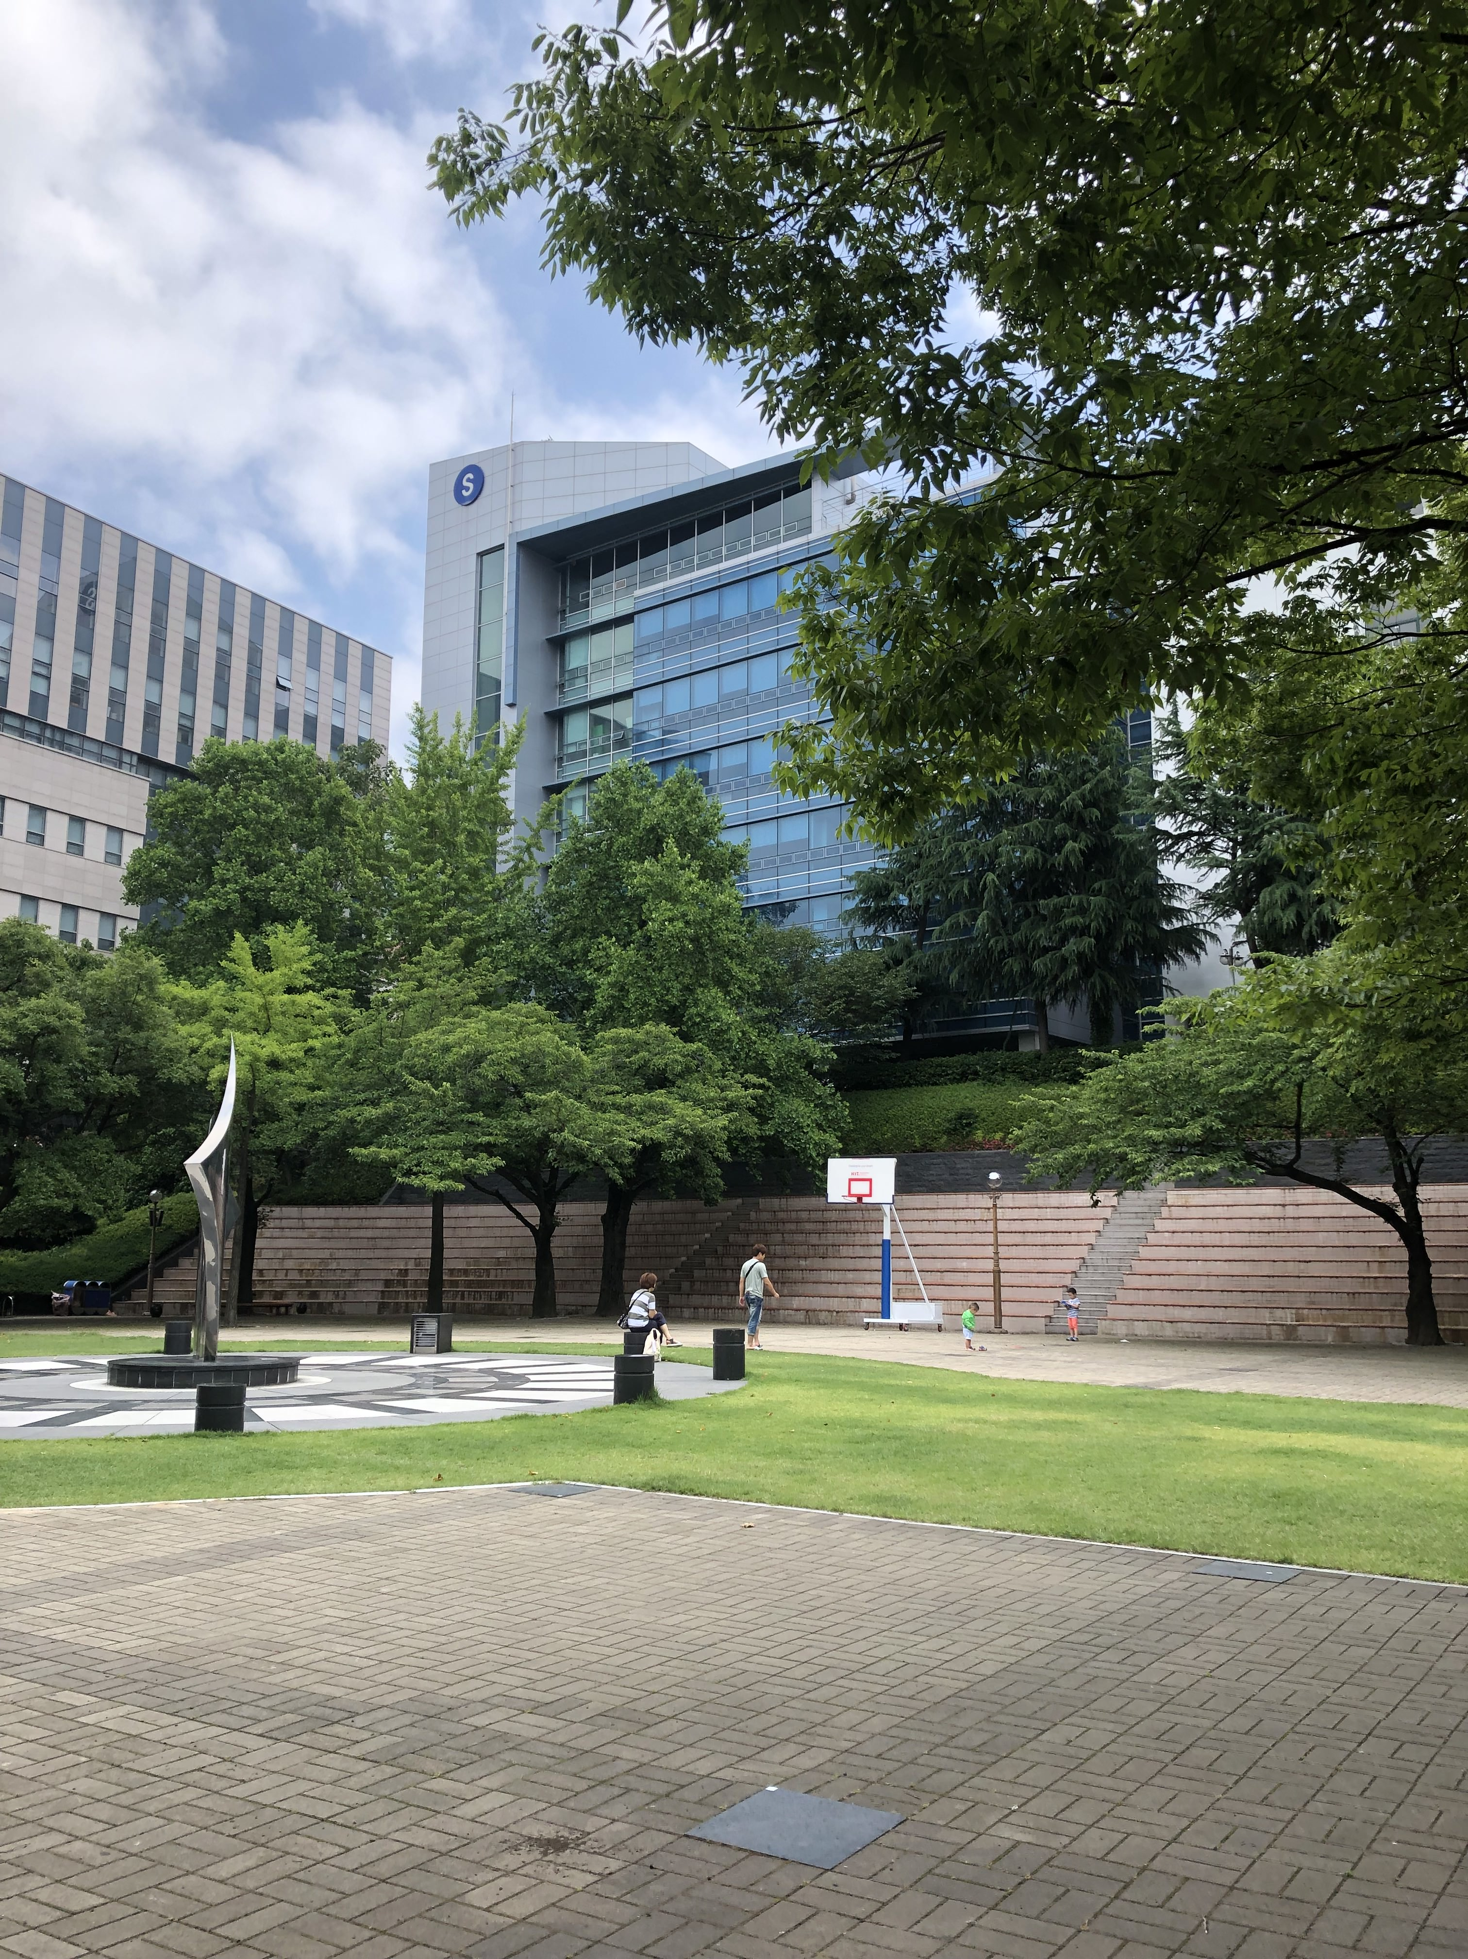
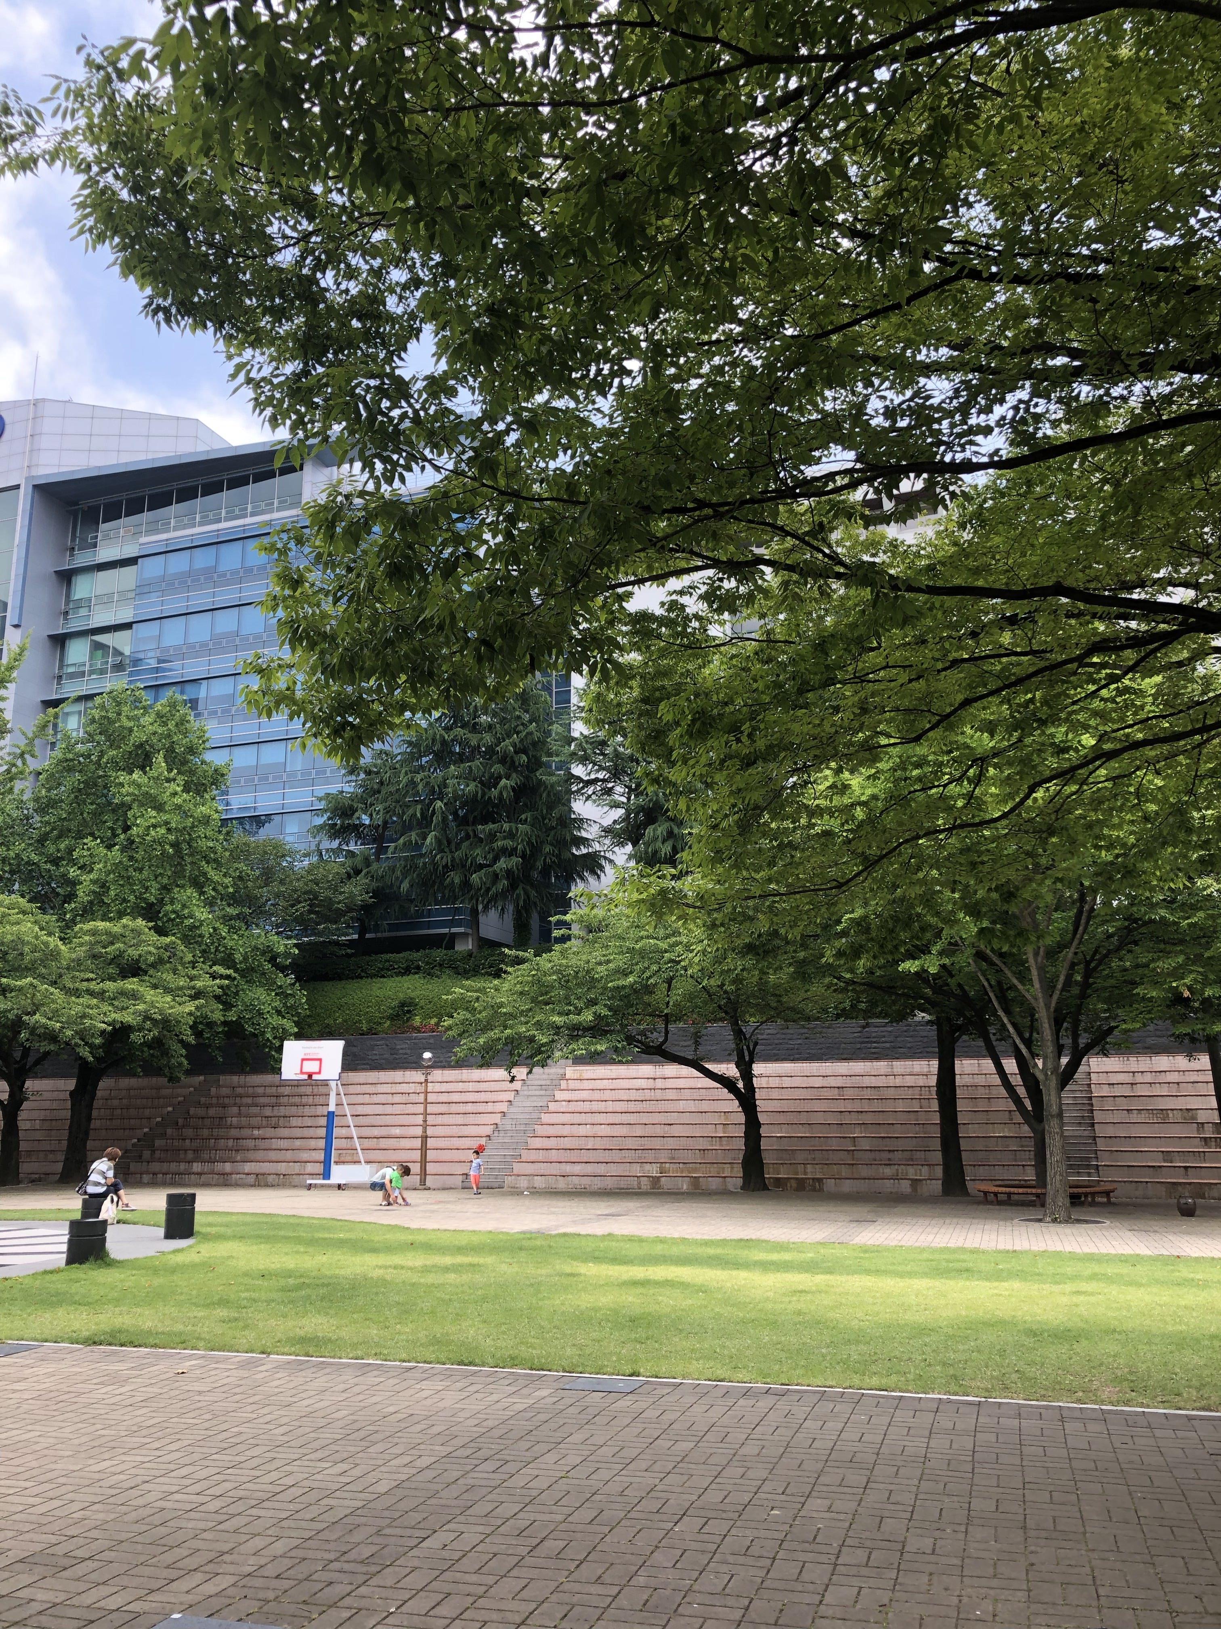
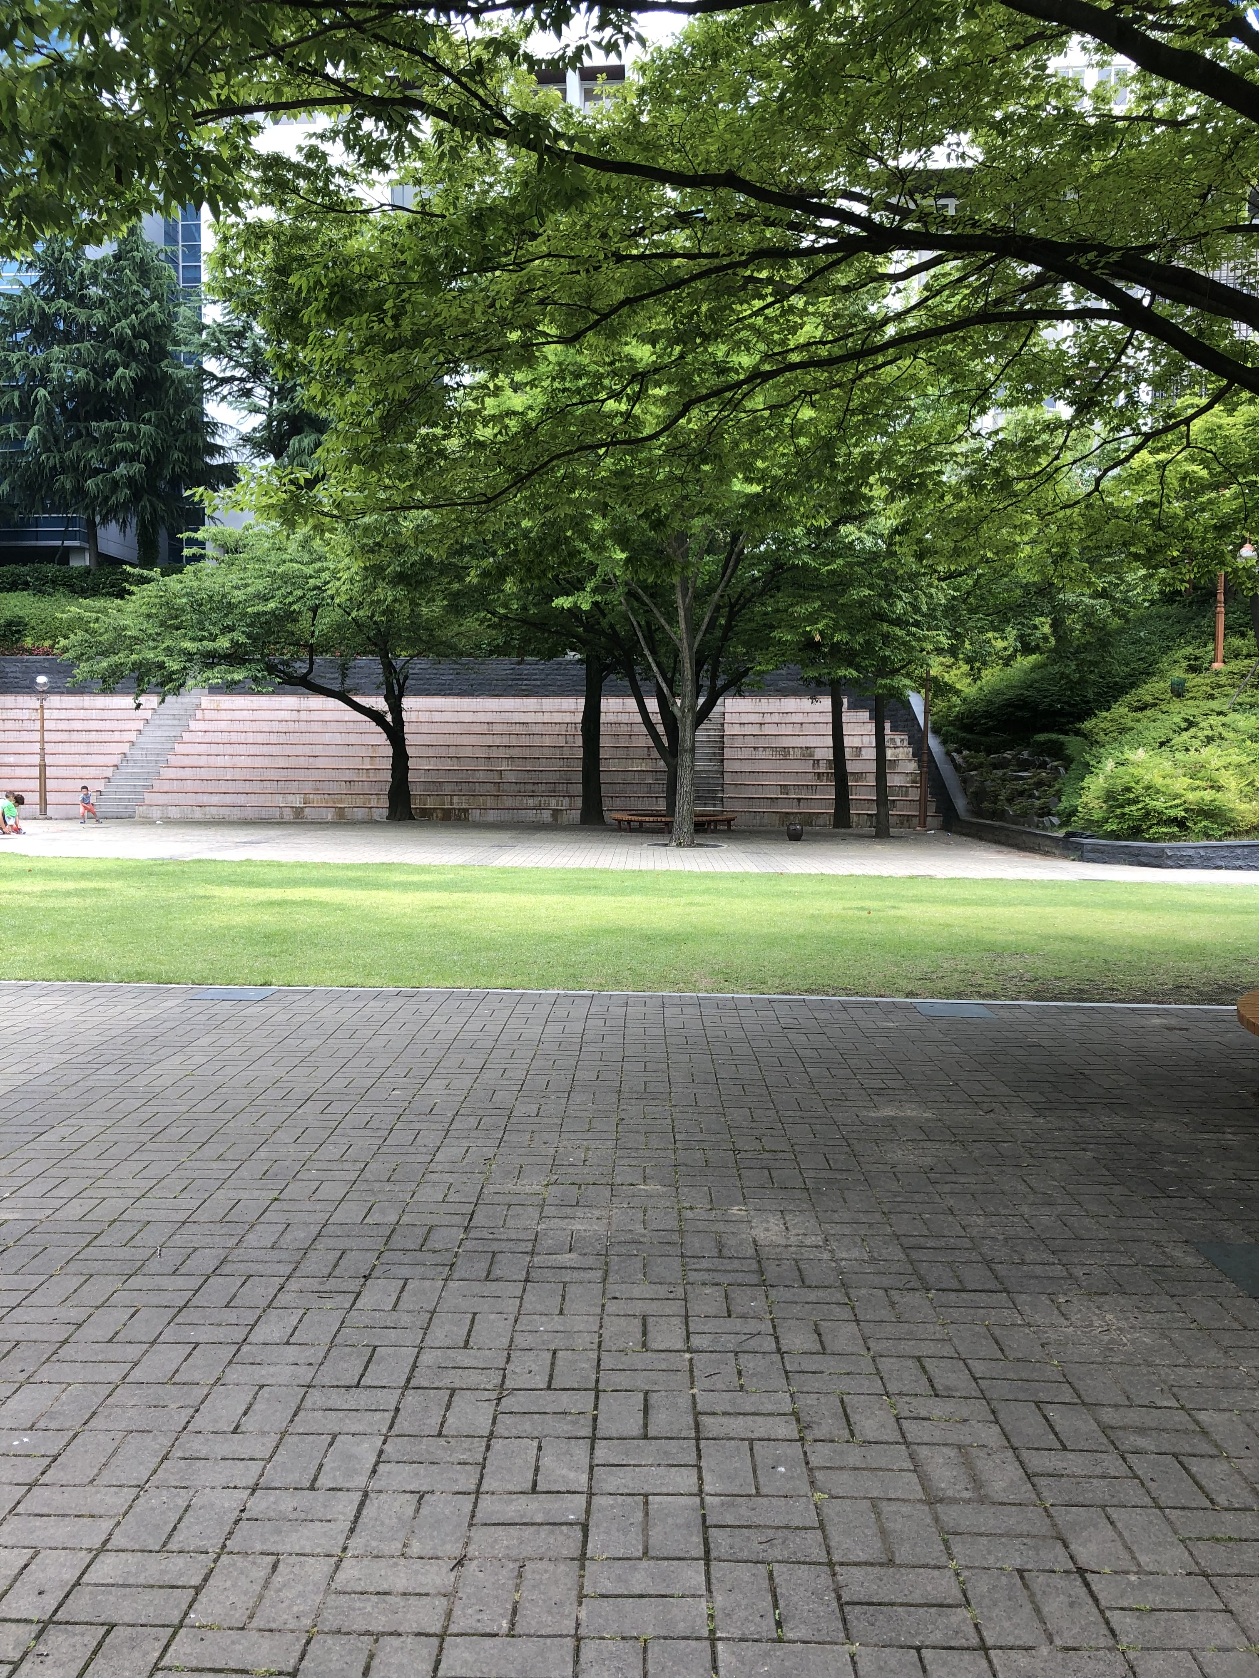
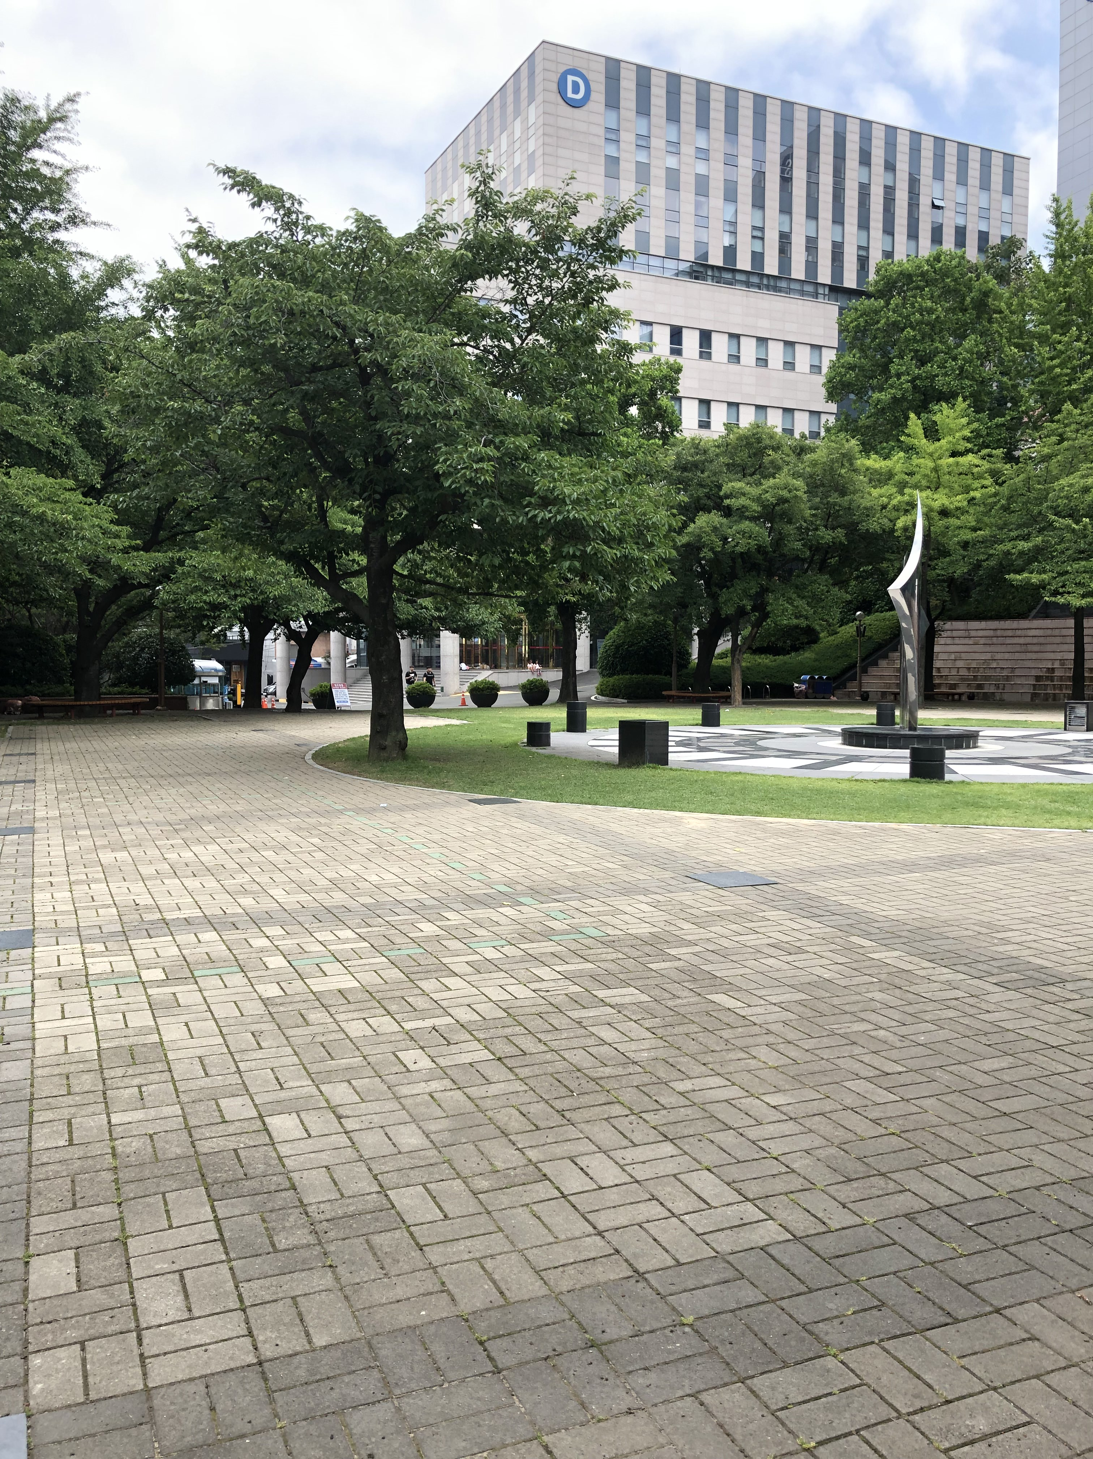
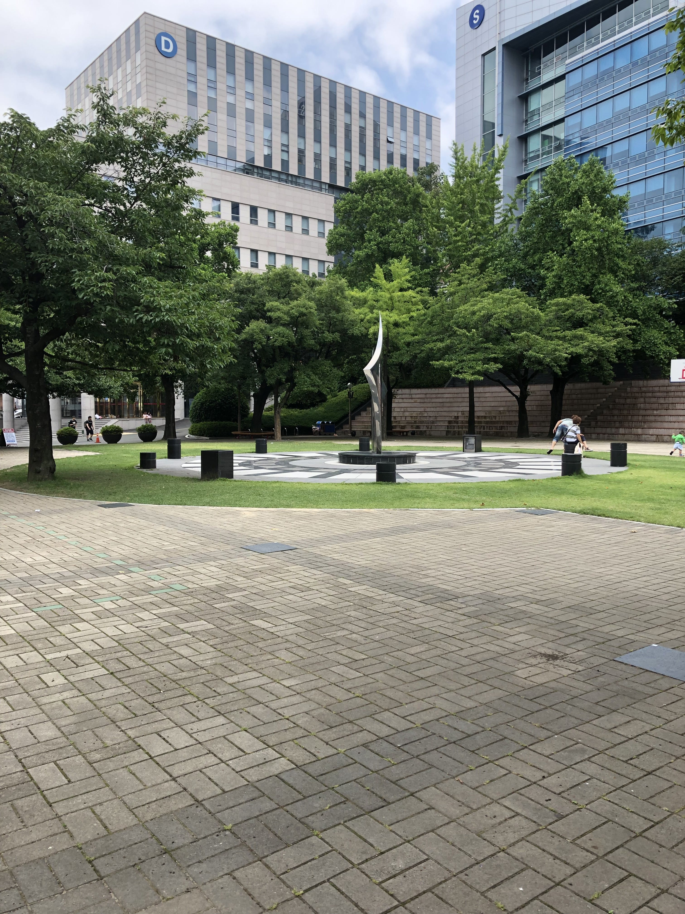
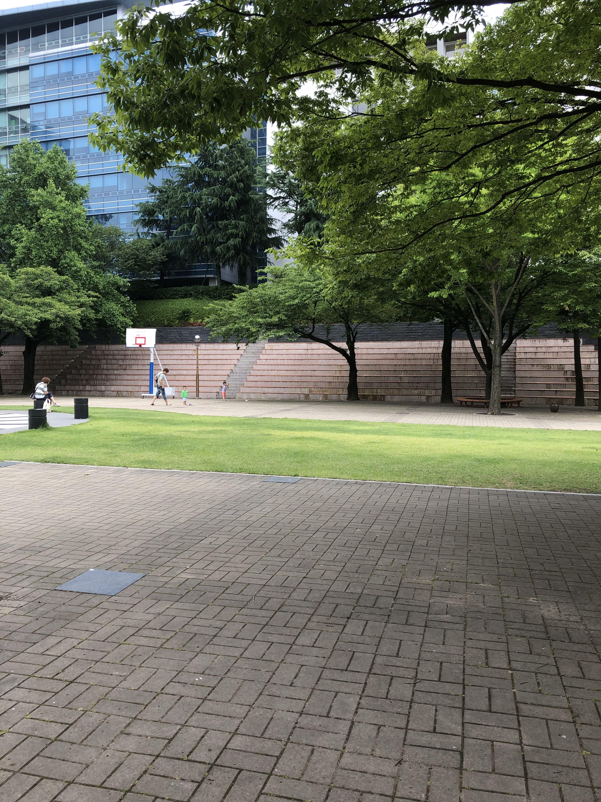
Input images
Notes:
A set of images. The algorithm detects connected components of image matches and unmatched images.

Slide 13
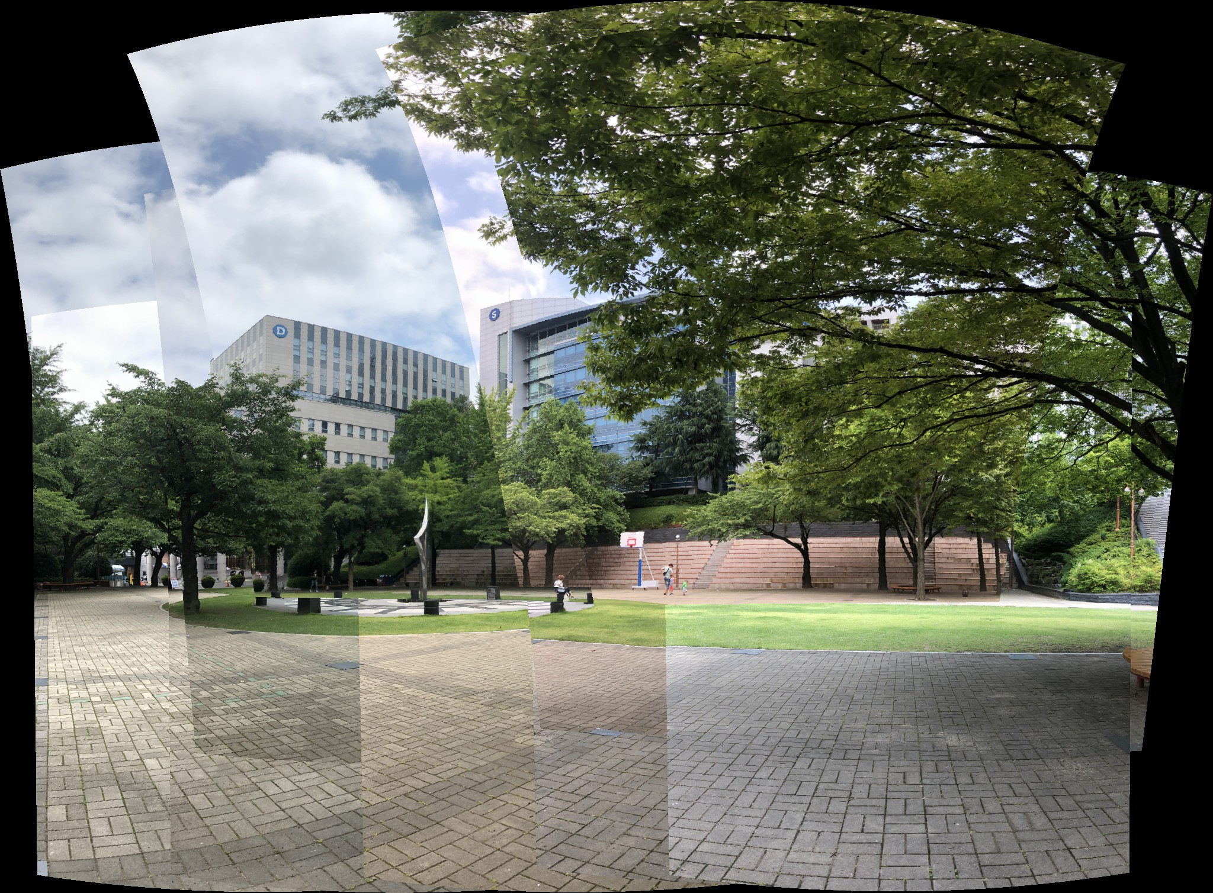
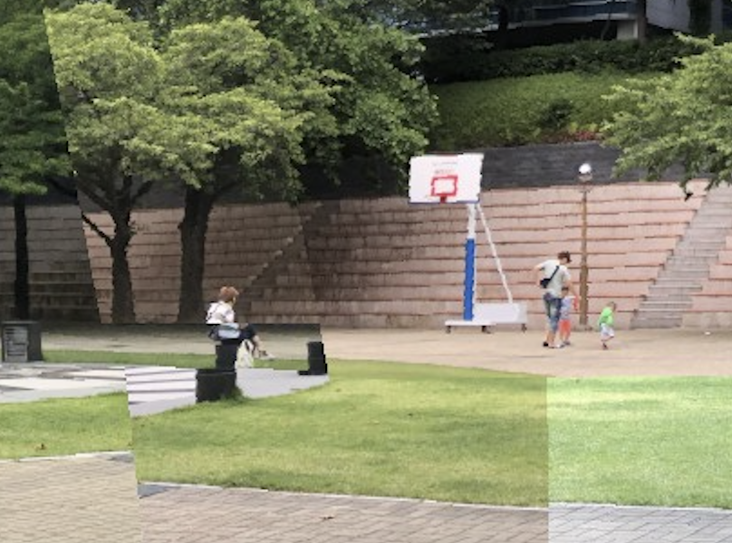
Blending option - off
Notes:
Some image edges are still visible due to unmodelled effects.

Slide 14
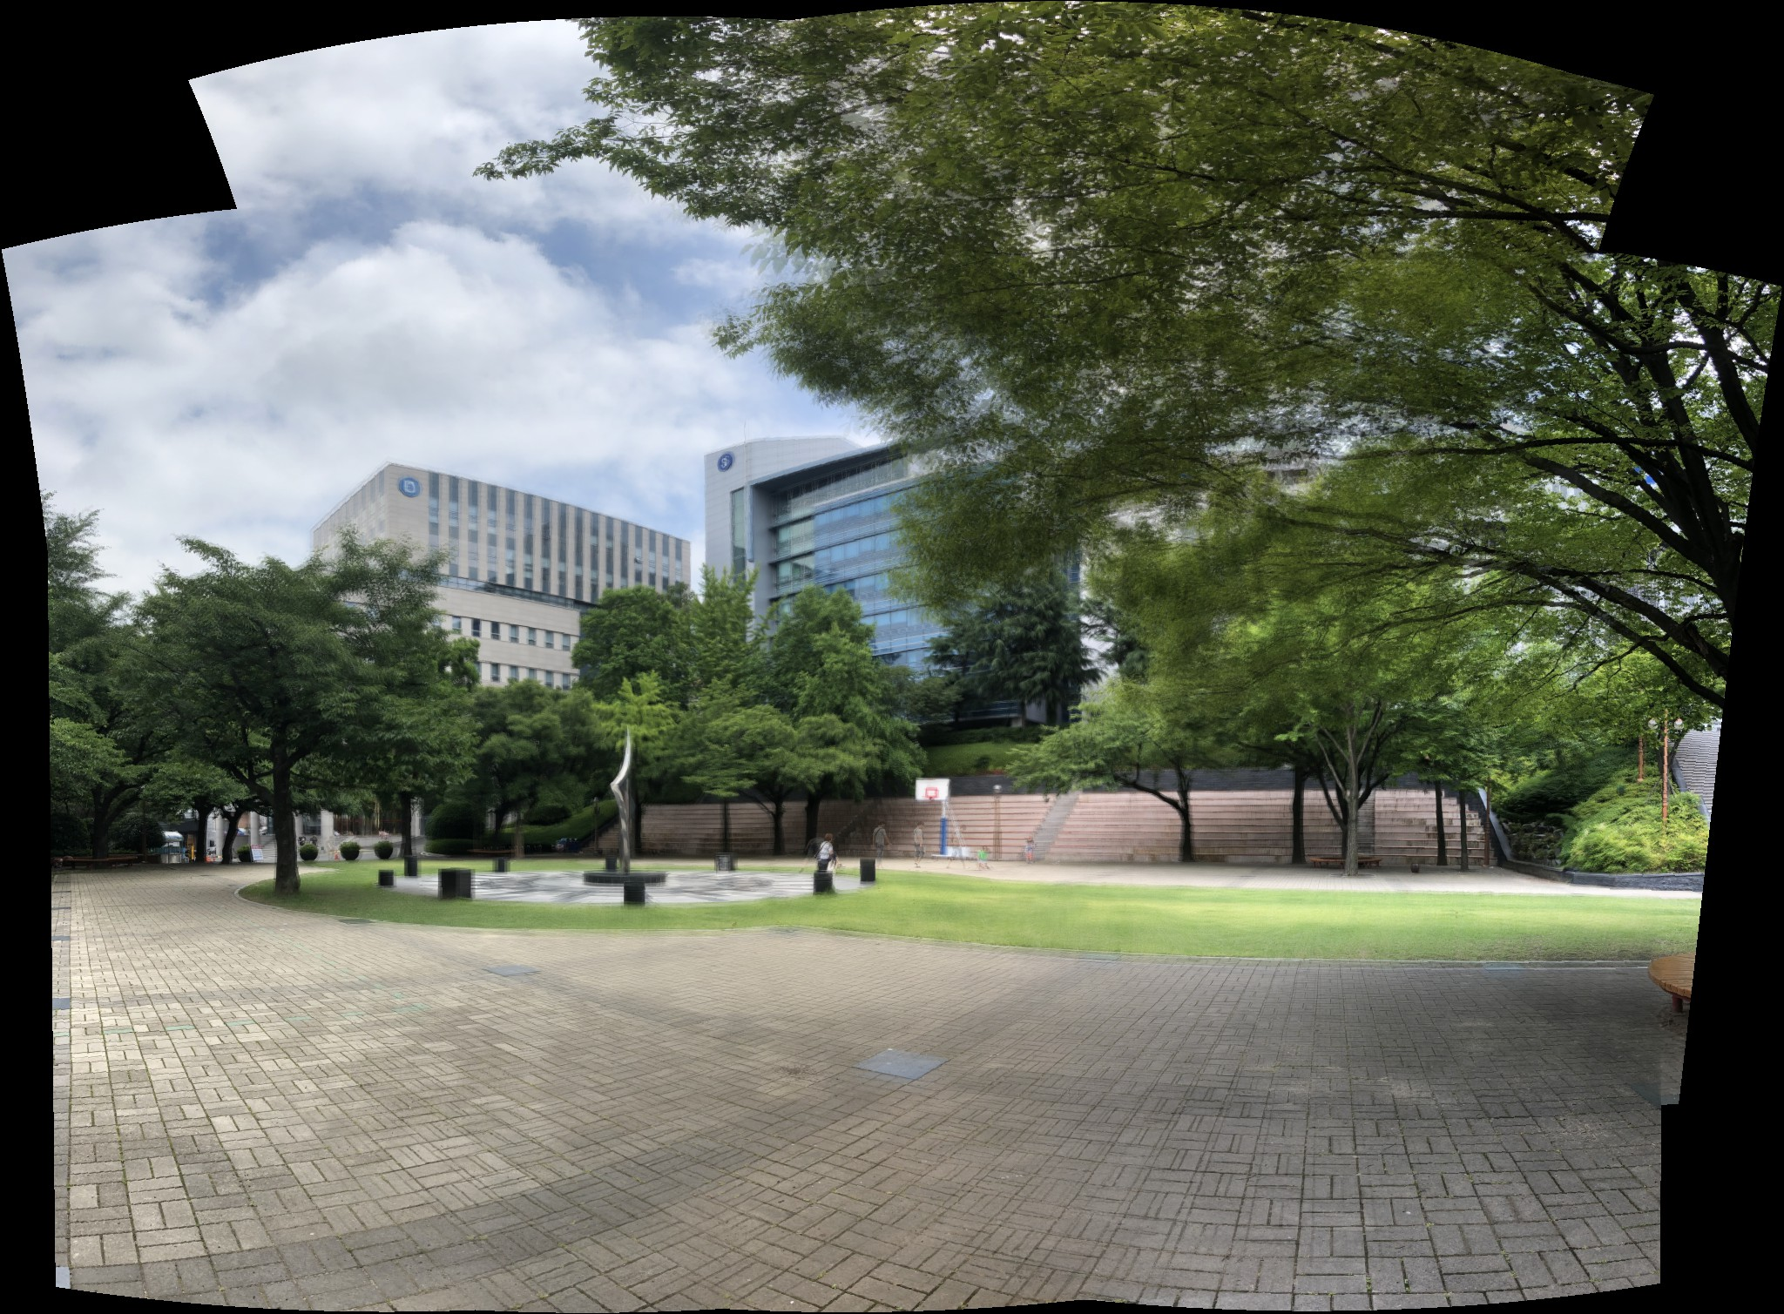
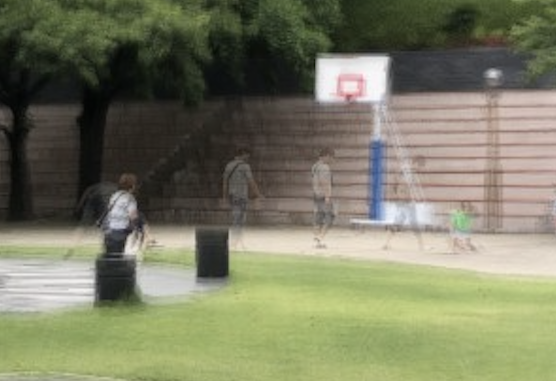
Blending option – linearly blended
Notes:
The image was linearly blended. In this cases, the matches on the moving person caused small misregistration between the images, which cause blurring in the linearly blended result. But the multiband blended image is clear

Slide 15

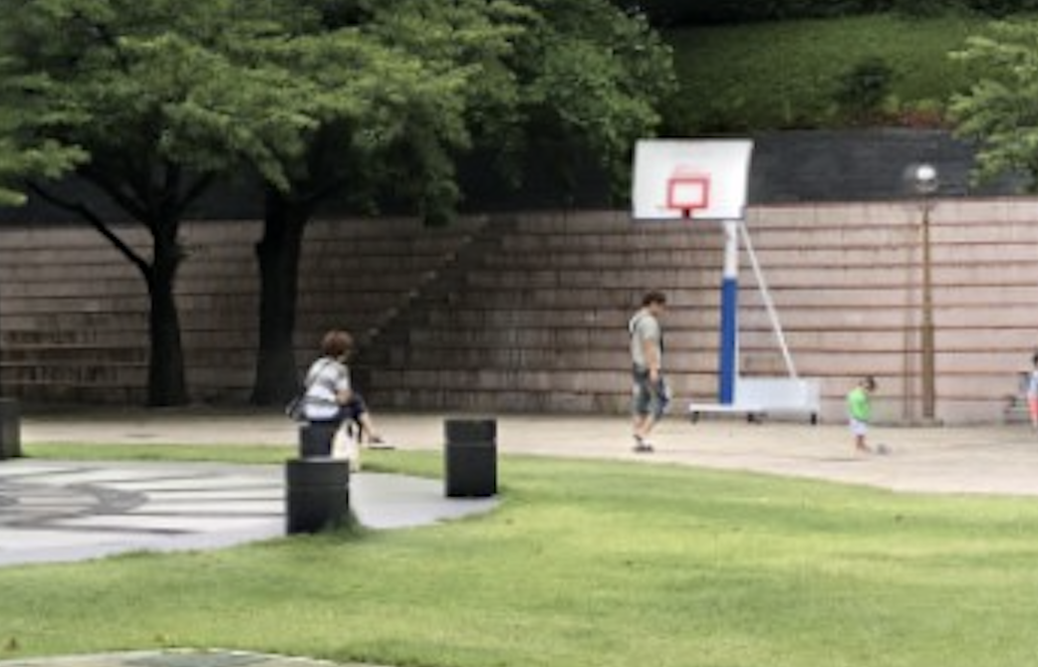
Blending option - Multiband blended
Notes:
the imges edges are no longer visible. All of the edges have been smoothed out using multiband blending.

Slide 16
Comparison on the blending option
None
Linear
Multiband

Slide 17
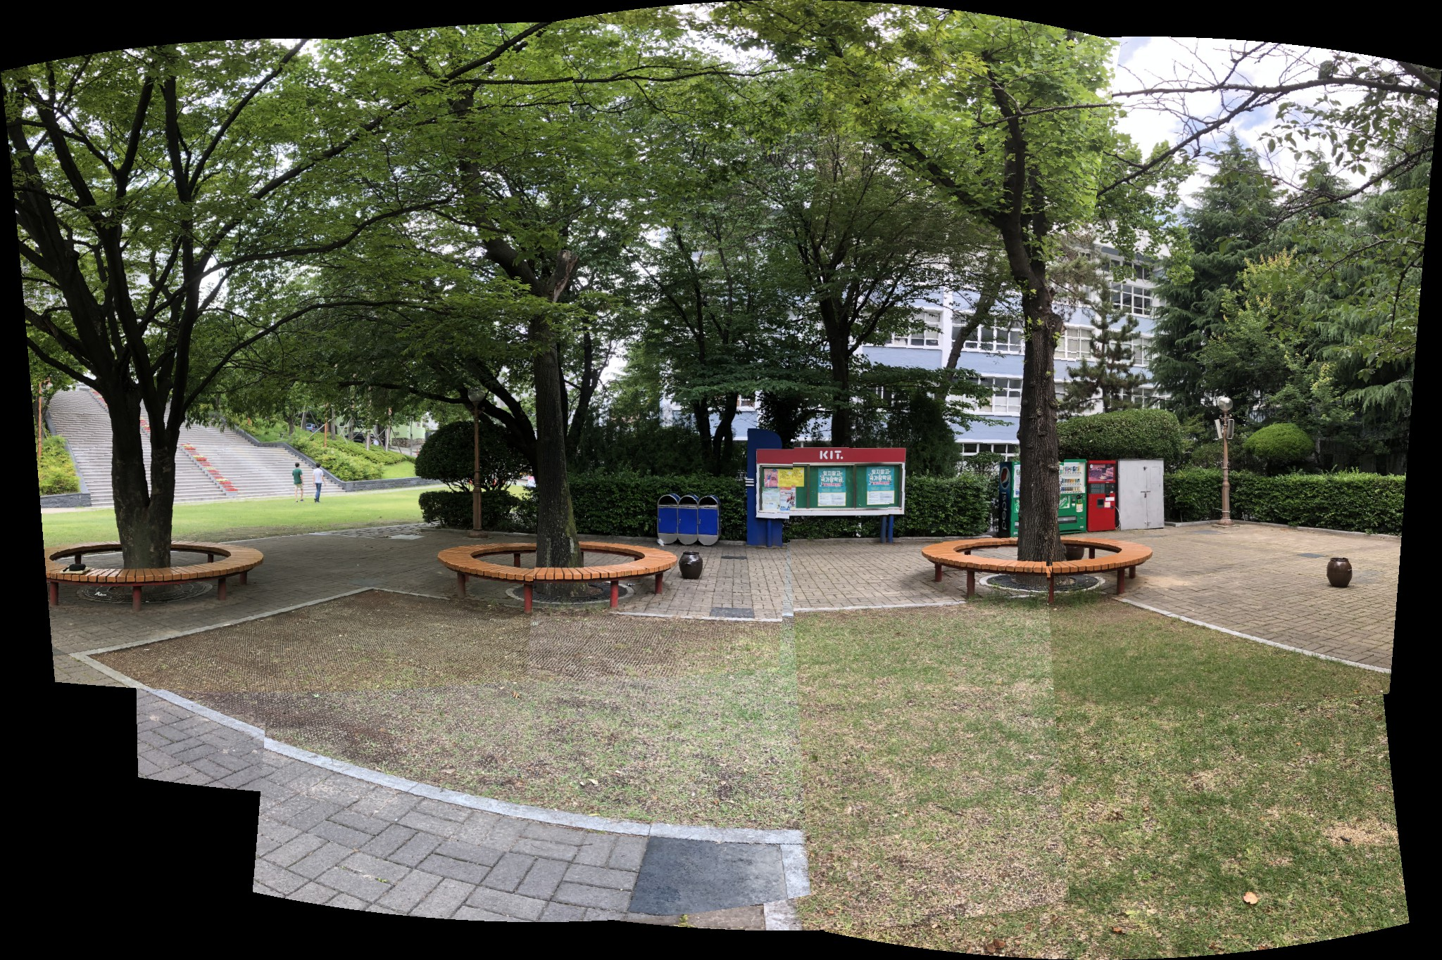
Blending option – None

Slide 18
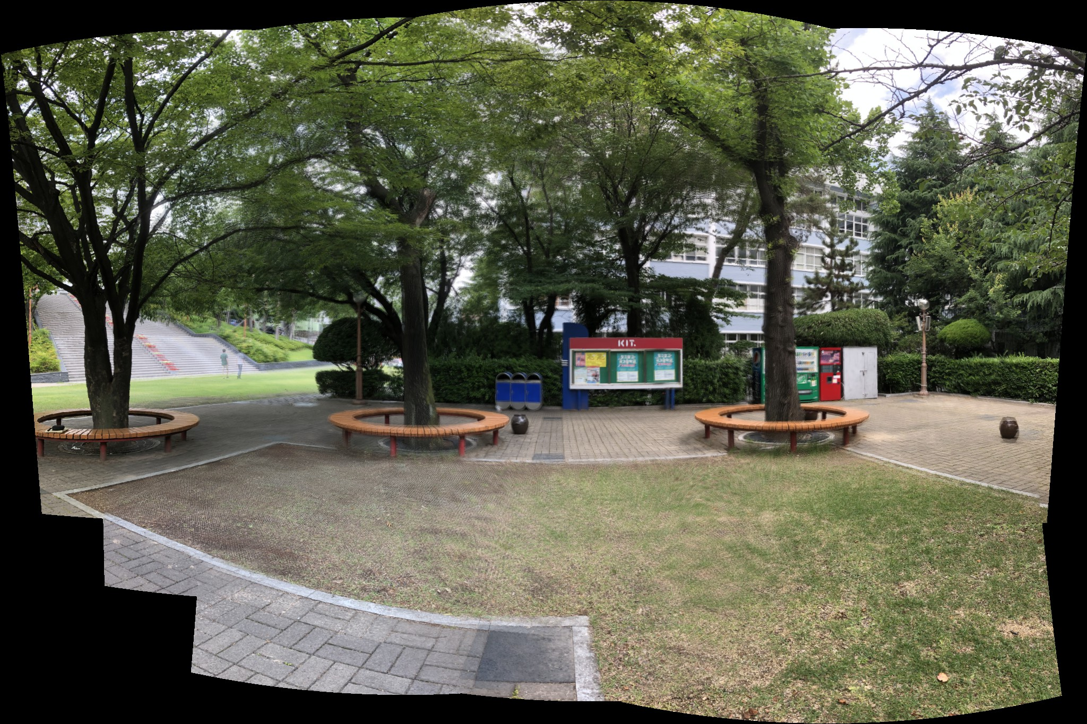
Blending option – linearly blended

Slide 19

Blending option – multiband blended

Slide 20
appendix
[Demo]
https://www.youtube.com/watch?v=0HLt2LLDhuI

Slide 21
references
http://matthewalunbrown.com/autostitch/autostitch.html
http://matthewalunbrown.com/papers/ijcv2007.pdf
https://en.wikipedia.org/wiki/Panorama
https://en.wikipedia.org/wiki/Image_stitching

